Slide 1
Pizza Sales Analysis
Project Owner: Ankit Raj Mishra

Slide 2
Objective
Find out how many customers do we have each day? Are there any peak hours?
How many pizzas are typically in an order? Do we have any bestsellers?
How much money did we make this year? Can we identify any seasonality in the sales?
Are there any pizzas we should take off the menu, or any promotions we could leverage?

Slide 3
On an average we have 136 customers per day &there are two peak hours 12:00 PM to 1:00 PM & 5:00 PM to 6:00 PM.

Slide 4
How many pizzas are typically in an order? Do we have any bestsellers?
We have 3 pizza are typically in an order and big_meat_s is the bestseller

Slide 5
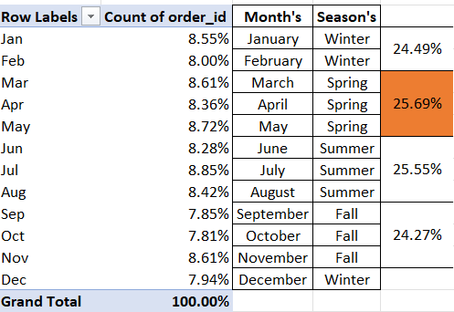
How much money did we make this year? Can we identify any seasonality in the sales?
We made this year $ 801,994.70 amount of money.

Slide 6
Are there any pizzas we should take off the menu, or any promotions we could leverage?
We can take off the pizza from the menu is : the_greek_xxl reason is simple it is lowest ordered pizza in that year and Since the Spring season already saw the largest pizza sales and the Fall season saw the lowest pizza sales, so we can provide a seasonal discount or special offers according to season.

Slide 7
Are there any pizzas we should take off the menu, or any promotions we could leverage?
We can take off the pizza from the menu is : the_greek_xxl reason is simple it is lowest ordered pizza in that year and Since the Spring season already saw the largest pizza sales and the Fall season saw the lowest pizza sales, so we can provide a seasonal discount or special offers according to season.

Slide 8
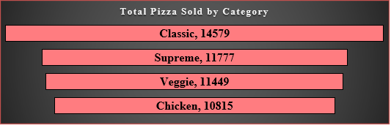
More Insights

